Slide 1
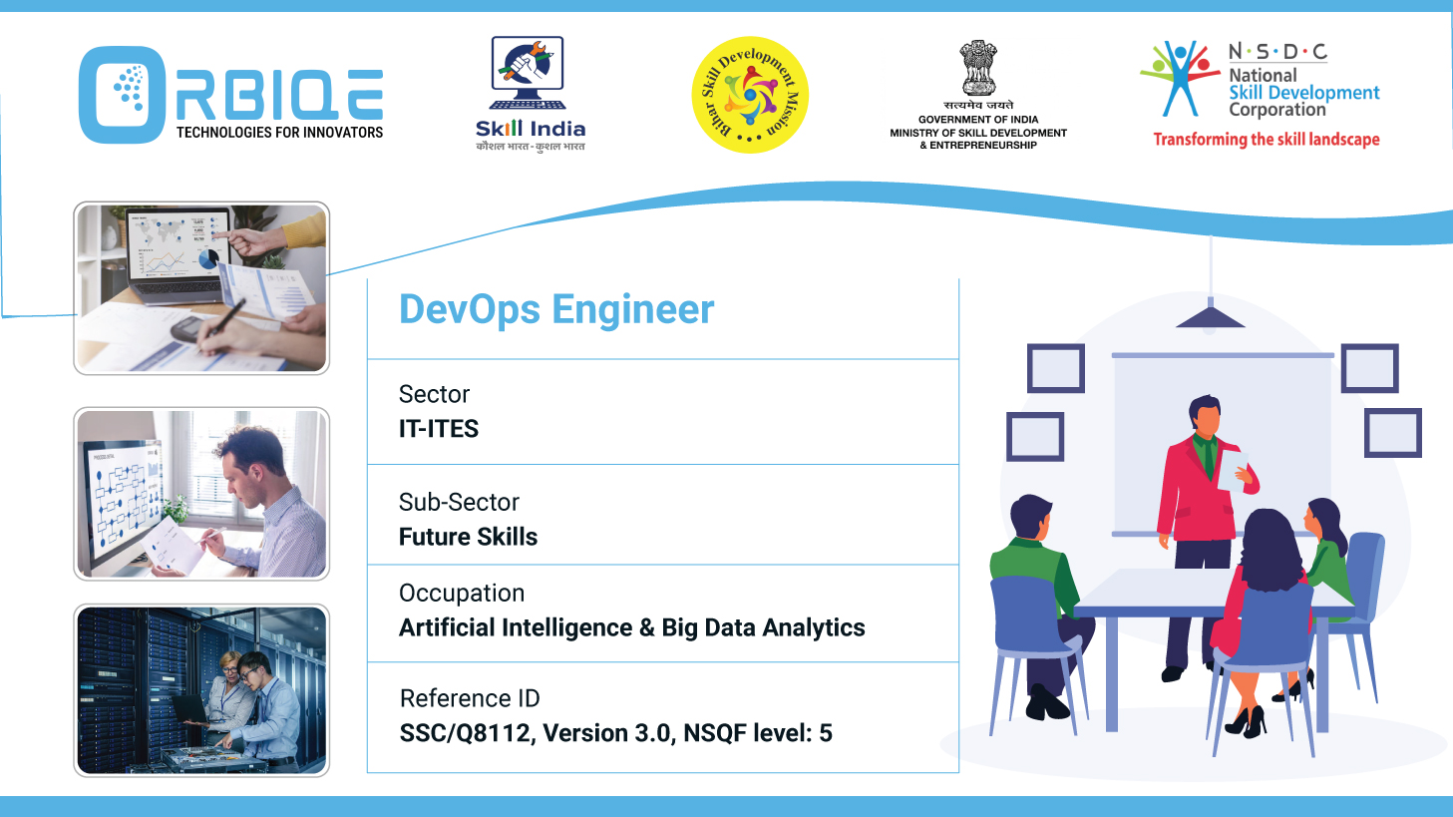
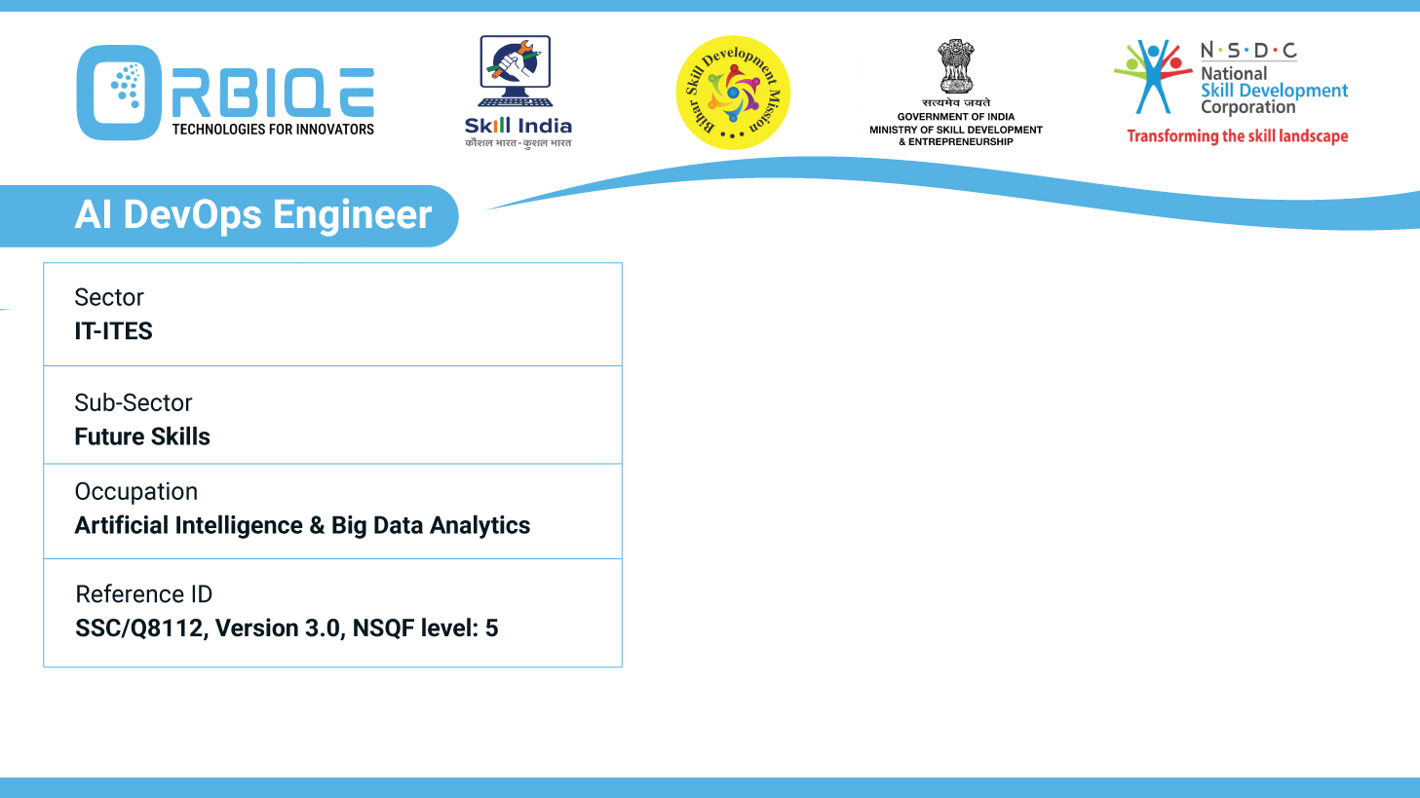
Name- Krishna Kant Dubey

Slide 2

Exploring Data Administration Tools and Computing Platforms

Slide 3
Agenda
Administration tools
Computing platforms
Frameworks
Libraries
Packages
Microservices

Slide 4
Administration tools

Slide 5
Computing platforms

Slide 6
Frameworks

Slide 7
Libraries

Slide 8
Packages

Slide 9
Microservices

Slide 10
Thank You

